Slide 1
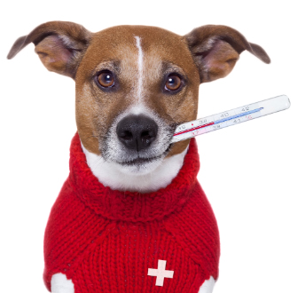

B For BARK
A DISEASE RECOGNITION SYSTEM

Slide 2
B For BARK
What is Disease Recognition System?
Disease management system is web based application where one can search for diseases according to the symptoms provided. The audience for this system is huge as in today’s world every age group has easy access to internet and every other person is concerned about health of their loved pets.
In today’s world every person is concerned about their pet and especially dogs, they care for their pet like their own child and have a serious concern about he health of the pet. If something happens to our pet we will not take rest until the pet is perfectly fit. The main targeted audience is the one who cannot reach to veterinarians easily. With this system they can just log in and check whether the symptoms visible are something to be given importance or not. This system could save lives of pets if its accuracy is maximised and if it has a huge databank of diseases and its symptoms.

Slide 3
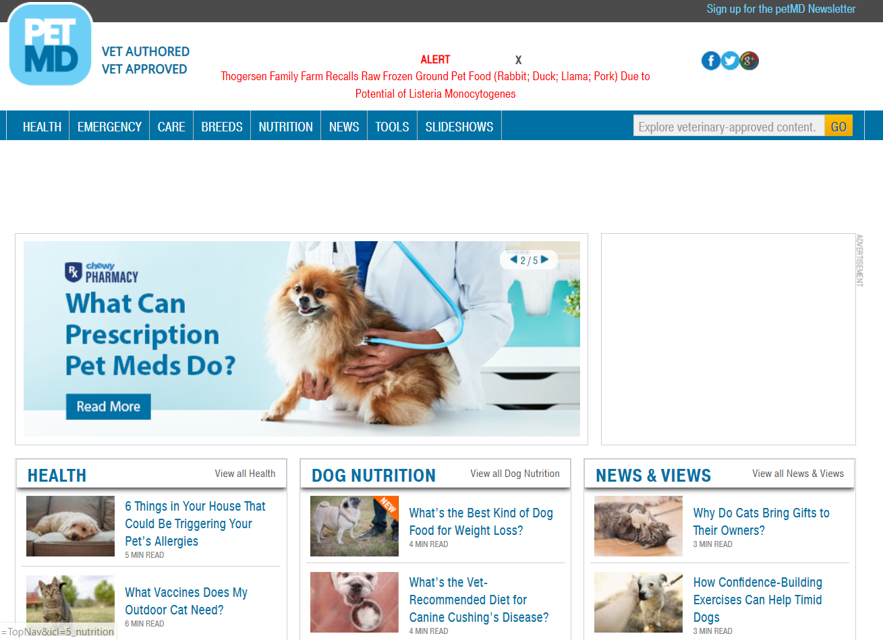
B For BARK

Slide 4
B For BARK
EXISTING SYSTEM
System Name: petMD
petMD is the largest global source of pet health information in the world today. Part of a global network of veterinary professionals, petMD’s content was created by veterinarians for consumers and veterinarians.
The content is written by veterinarians and approved by the veterinarian’s team. Hundreds of veterinarians, spanning eight countries across the world, were consulted, interviewed and enlisted to write, verify, and approve the content.
petMD contains three basic functionalities:
Search for pet health database
Connect with a veterinarian and visit them often
Discover new things that will inspire you to keep your pet healthy

Slide 5
B For BARK
LIMITATIONS OF EXISTING SYSTEM
Existing framework has a manual search which is hard for client. The user can only get details of certain outcome as in they have to guess the actual disease and search for it on the system. Basically this system cannot recognize any disease. And furthermore there is no health card for each dog where the veterinarians can view the details related to the dogs whom they are currently treating and the previous history of the dog’s treatment.

Slide 6
B For BARK
BENEFITS OF PROPOSED SYSTEM
Our system automatically searches for the disease and gives the outcome, basically a recognition system. In the Existing framework we have to manually search the details about the concerned disease which is not feasible for the user in most of the occasions.
Furthermore, we are additionally exhibiting the trend analysis about the searched disease with a graphical portrayal.
In our system we provide the user with the user friendly interface which gives substantially better outcome in detail.
With regard to Trend Analysis we will be providing food for the month.

Slide 7
B For BARK
SPECIALIZATION CONCEPTS USED
We are proving the trend analysis of recently searched diseases with the graphical representation.
We are having a recognition system which will predict the disease according to the symptoms given so that the user does not have to search for it manually.
Our system helps user to chat in case of assistant needed through CHATBOT.
Through trend analysis we also recommend Food for the Month components.

Slide 8
B For BARK
Feasibility study:
Technical feasibility: It is possible to construct the whole system using a free front end tools and a back end tool such as MySQL. Moreover, through proper normalisation the data can be properly segregated and anomalies regarding any operations can be minimised and the accuracy of the output can be maximised.
Hence through proper consideration of the system we can say that this is a technically feasible project.
Economic feasibility: The resources to make this project is readily available. And the scope of the audience is huge and easy access of the system would make it popular with the crowd making this system economically feasible.
Operational feasibility: It is safe to assume that the proposed system is operationally feasible as the resources required to construct the system are available and this system has the capacity to make the life of lay man easier.

Slide 9
B For BARK
NON FUNCTIOANL REQUIREMENTS
MINIMUM HARDWARE REQUIREMENTS:
CPU: 500MHz
Memory:500 MB
Storage: 500MB
MINIMUM SOFTWARE REQUIRMENTS:
Windows 7 (OS)
MySQL
WAMP Server
Sublime / Brackets (Text Editor)

Slide 10
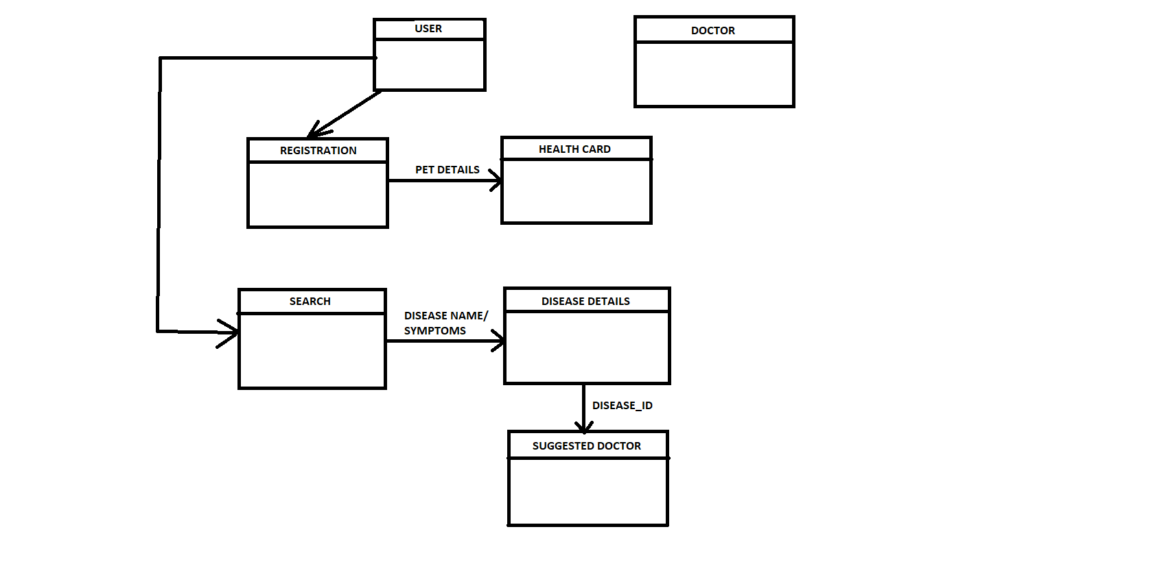
B For BARK
Block Diagram of Proposed System

Slide 11
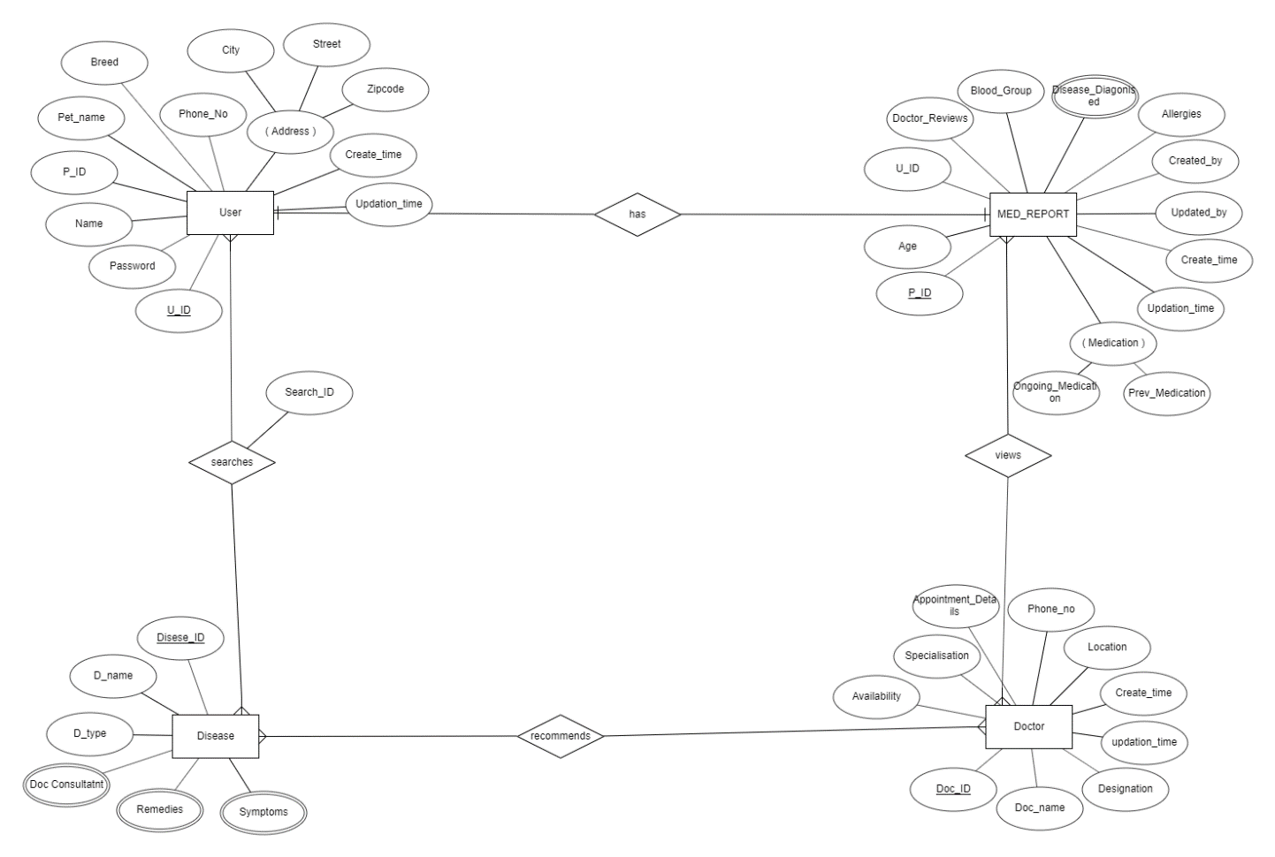
B For BARK
ER Diagram

Slide 12
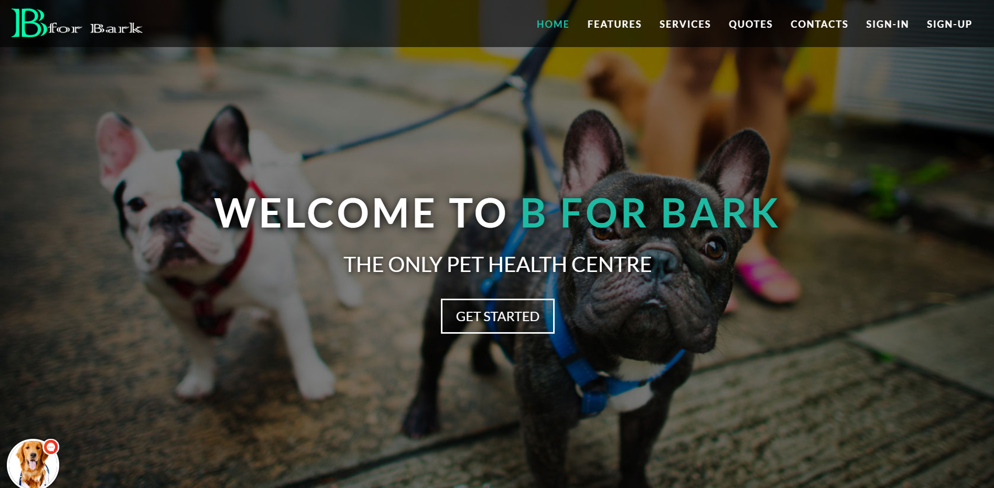

Slide 13
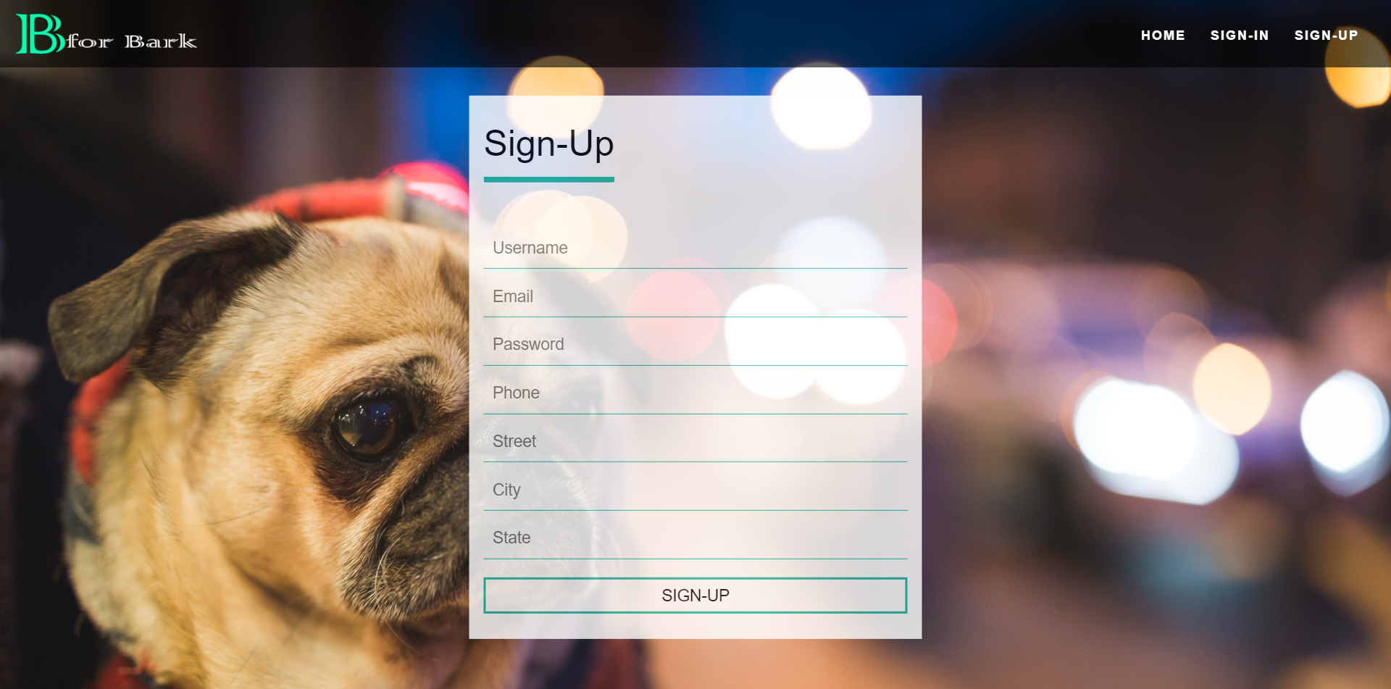

Slide 14
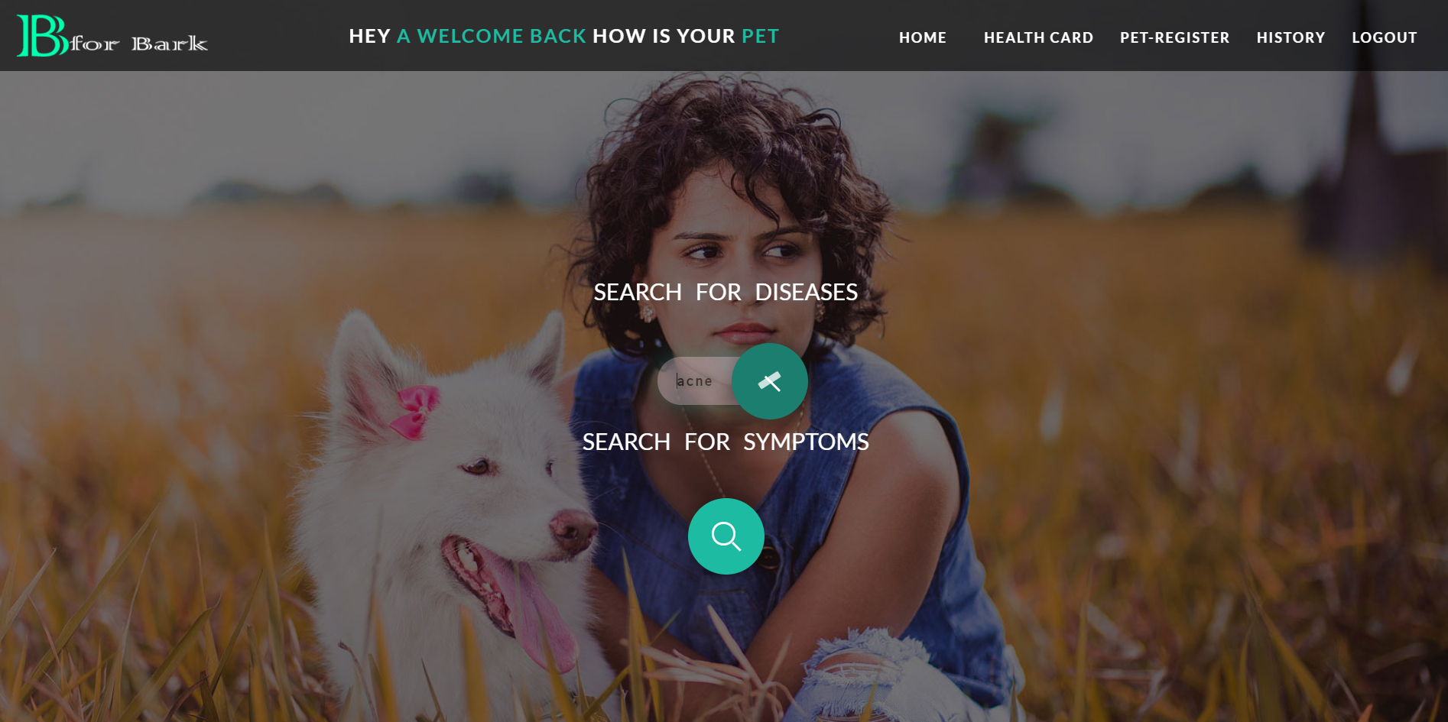

Slide 15
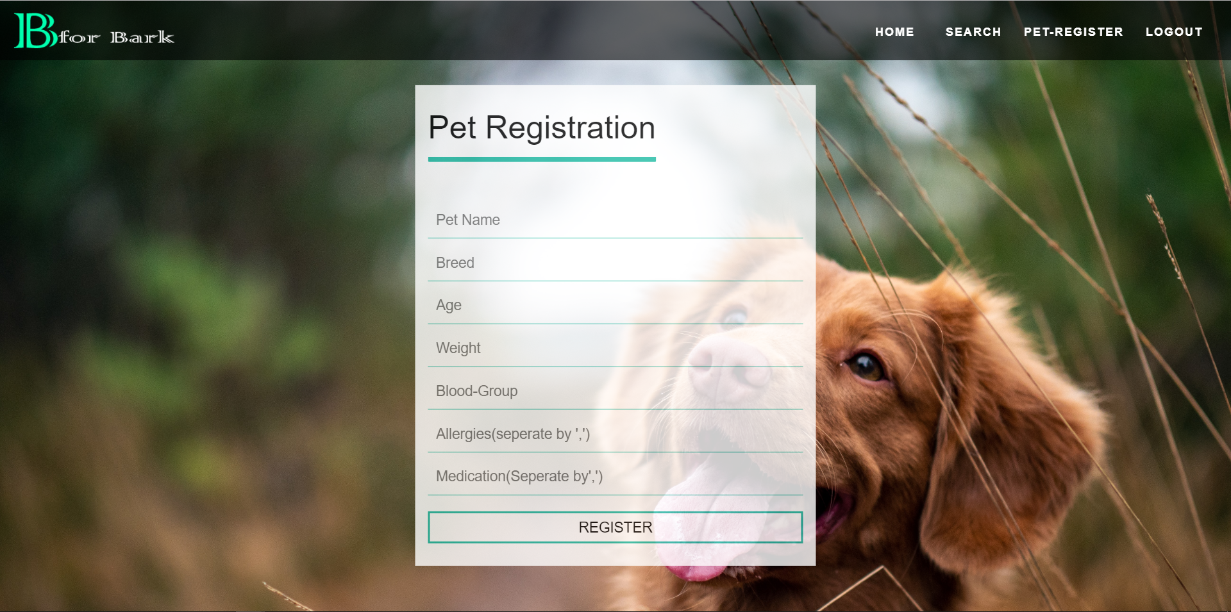

Slide 16
THANK YOU
Guide: Dr. Nismon Rio R
Presented By: -
Koustabh Krishna (1847234)
Nithya V (1847245)
Jaiprakash Advani (1847229)

